Slide 1
Unit 4
ICT A level
Revision

Slide 2

Remember!!
The focus of A level questions is on you being the designer / advisor to organisations wishing to develop their ICT capabilities
A level questions can contain areas from your As knowledge
You may be asked to apply A level theory to the applications you studied at As

Slide 3
Unit 4
Networks

Slide 4
Computer Networks
A computer network is a collection of computers linked together so that they can communicate with each other
A computer that is not connected to a network is called a stand-alone computer
There are two different sorts of computer network:
  ‘Local Area Network’ or ‘LAN’ - the computers are all in the same building or in different buildings on one site permanently connected to each other with special cables.
  ‘Wide Area Network’ or ‘WAN’ - the computers are spread over a large geographical area not permanently connected to each other communicate using telephone lines, radio transmitters or satellite links. Connected by gateways

Slide 5
Factors to consider when choosing a network
1. Cost of the network
Initial purchasing of equipment
Installation and training
Maintenance costs
Size of the available budget will determine what can be done e.g. fibre optic cable is faster but is also more expensive. Wireless systems are flexible but need more maintenance.

Slide 6
2. Size of the organisation
Needs can range from a small LAN to a global WAN.
Some communications media are limited to the distance they have to travel.
Amount of data processing required must also be considered.

Slide 7
3. How the system will be used
What type of applications do users require?
Will they need large data storage?
From where will they operate the network e.g. at home in office or remote access from different locations

Slide 8
4. Existing systems to integrate
More often networks are not developed from scratch but need to fit in with existing systems. Sometimes an extension is required e.g. when a new branch office opens.
Therefore any new network must fit in with the operating systems and protocols of the existing.
It must support any peripherals already in use e.g. bar code readers, printers etc..

Slide 9
5. Performance and speed required
Performance in terms of ;
reliability
user friendliness
capacity
speed of processing.
Different parts of the organisation may have different performance requirements. E.g. a real-time e- commerce system may require greater speeds and capacity and security than the in house payroll system

Slide 10
6. Security issues
Different organisations may have different
priorities e.g.
A large business organisation may be primarily concerned with
  Prevention of hacking
  Avoid viruses
  Secure payment site
A school may be equally concerned with blocking the downloading of illicit material

Slide 11
Clients (Terminals)
Thin clients (‘Dumb terminal’)
Has no built in hard drive, expansion slots and only has enough RAM and processing capacity to run applications and output to a monitor
Suitable for client server networks.
Fat clients (‘Intelligent terminal’)
This is a workstation with full stand alone capacity. It has its own hard drive for storage and a CPU.
Stations have a processor so can share the processing. There are many different ways to do this e.g. a station could act as a printer server etc. A station could store programs on its disc and load them while data files are stored elsewhere perhaps upon a central fileserver.
Suitable for peer to peer networks

Slide 12
Both LANs and WANs may be either
Client/Server
or
Peer-to-Peer networks.

Slide 13
Peer to peer network
All stations are joined together in the network have equal status.
Each station can communicate directly with every other workstation on the network without going through a server.
They are both client and server sharing resources.
Are often a form of distributive processing sharing the processing between intelligent terminals.
Hardware and data files can be access from several computers.
Applications may be stored on different computers and accessed by all as longer as the owner gives permission.
Work is backed up on individual user PCs.

Slide 14
Client Server Network
The term Client/Server is used to describe networks that
have computers or terminals (clients) that are connected
to a more powerful computer called the NETWORK
SERVER.
A central file server store the data and programs
Access is determined by user access privileges controlled
by their logon names and passwords
A print server would spool data ready fro despoiling to a printer when the printer is ready
A communication servers e.g. web server; email server may control all email and internet access.

Slide 15
Peer to Peer | Client server
Cheaper: initial start up costs and network operating system less complicated | More expensive as software system more complex and need to but servers.
Less vulnerable to central server crashes | If server crashes or cable fails no user can continue work
Simpler to set up and maintain | Require specialist personnel to manage system
Slower processing of tasks | Faster processing of tasks
Only works well on small networks <15 | Can manage large networks
Security and backup are not centralised and difficult to manage | Centralised control with servers often doing many management functions themselves e.g. regular backups, auditing
Access to data depends upon the owner’s permission. | Offers easy access to centralised data

Slide 16
Network Topology
Network topology refers to the layout used to connect the computers together. There are three common topologies:
      Bus
      Ring
      Star
Any of these topologies can be used regardless of whether a network is local or wide area, server based or peer-to-peer.

Slide 17


BUS
Workstations are connected to the main central cable/bus
Data can travel in both directions
Two nodes could attempt to transmit at the same time and a collision will occur. To avoid this, a node waits until no traffic on the bus and pauses slightly before transmitting. If a collision occurs both nodes wait and try again at a random time interval.
The main bus standard is known as Ethernet the communications uses a broadcast channel so all attached workstations can hear every transmission.
2.This is the cheapest network topology as the smallest amount of cabling is required

Slide 18
Fileserver
Terminator
Terminal
Terminal
PLOTTER
PRINTER
Advantages
Less cable need than a ring. Relatively cheaper and easier to install and maintain.
Easy to add new nodes by removing terminator
If a workstation/terminal goes down the others will continue
Disadvantages
Heavy traffic can cause network failure and delays
Heavily dependent upon the cable backbone and cable damage can cause network failure.

Slide 19
RING NETWORK
The Cambridge ring has no central host computer and none of the nodes need to have overall control of access to the network. Messages in the ring flow in one direction from node to node.
The ring consists of a series of repeaters which are joined by cables.
PRINTER SERVER
RING
CABLE
T8
T1
COMMUNICATIONS
SERVER
T2
T7
FILESERVER
SCANNER
HARD
DISK
T6
T3
T5
T4
The choice of cable depends upon the distance to be travelled and required speeds. Fibre optic cabling is the best but the most expensive. Fibre optic cabling would allow a ring of about 100 kilometres.

Slide 20

Token passing technique
An imaginary token is continuously passed around the RING. A token is a small packet that contains bits of data which passes around the ring (Always the same way around)
The token is recognised as a unique character sequence.
If a device is waiting to transmit it catches a token and with it the authority to send data. It attaches its data. The packet will contain the destination address.
As long as one device has a token no other device can send data.
A receiving device acknowledges it has received the message by inverting a 1 bit field.
Once the sending workstation has received acknowledgement that the message has been received the token is free for use by another device.

Slide 21
Advantages of a Ring network
There is no dependence upon a central host as data transmission is supported by all devices on the ring. Each node has sufficient intelligence to control the transmission of data from and to its own node.
Works effectively when processing is distributed across a site.
Very high transmission speeds are possible.
It is deterministic i.e. different performance levels can be determined for different traffic levels.
Routing between devices is simple because messages normally travel in one direction.
As data is in one direction it can transmit large volumes of data
Disadvantages -
Systems depends upon the reliability of the ring repeater although it can be designed to bypass faulty repeaters. If one node malfunctions this can affect the operation of the network.
Cabling costs
Difficult to extend the ring.

Slide 22
STAR NETWORK
Each node is connected to a CPU at the centre. Popular topology for a WAN.
Messages pass through host which interconnects different devices on the network. The central host switches messages point to point.
T6
T7
T8
Scanner
HARD
DISC
FILESERVER
COMMUNICATIONS
SERVER
T5
PRINTER
T4
T1
T2
T3

Slide 23
Advantages of a Star network
Suitable for WANs where large organisations rely on a central computer for the bulk of data processing tasks
Central control of message switching allow a high degree of security
Each spoke is dependent upon the rest. If one spoke breaks down the others can continue and the central CPU can identify any faults
Data transmission speeds can vary from spoke to spoke so one can use a high-speed device and another a low speed e.g.. disc drive.
Saves cabling.
Disadvantages
Network is vulnerable to central hub failures.
As a distributed system, some processing is still possible at the nodes but internode connection is lost.
If servicing a WAN a mini or mainframe system is needed for control of messaging. So hardware and software is expensive.

Slide 24
A Wide Area Network (WAN)
Workstation
Workstation
Workstation
Print Server
File Server
Printer
Gateway
Modem
Remote PC
Remote PC
Modem
network cables
telephone lines

Slide 25

LANs and WANs
LAN in shop
WAN with HQ

Slide 26
Internet, Intranet and Extranet
The Internet is a Wide Area Network - actually it is a huge collection of networks connected together by what are called gateways - these make the system act as if it was one huge network.
Many networks in industry, business, higher education and government institutions are all connected to the Internet although anybody can now get connected to the system with the appropriate hardware and software and access to an ISP (Internet Service Provider )...e.g. Freeserve, AOL, Demon and hundreds of others.
A user can get information on just about everything. There are search tools which allow you to search the World Wide Web for any topic, and each page has links to another and so on....
- it is also possible to download software and files (e.g. NASA graphics)
- bulletin boards (forums) or newsgroups are also set up where you can leave messages, or communicate directly with other users.
Businesses set up websites on the Internet because...
..they can advertise. It enables people to find out what they do and what they sell.
..people can email them with enquiries; orders; requests;
..they can reach an international audience.

Slide 27
Intranets
An intranet is set up entirely within a LAN. Web pages can be stored and accessed from anywhere on the network and email can be sent internally within the LAN.
A company can set up an intranet and allow its workers to send messages to each other and use a browser to access company information saved as web pages. It can also be used for staff training.
Extranets
If a company allows some access from outside to its intranet, then it becomes an extranet. Access would normally be through a firewall (software which only allows permitted users to access the data).

Slide 28
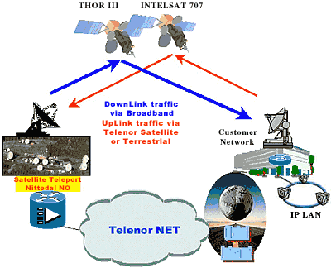
Wireless Media
Infra-red
Radio waves
Bluetooth
Broadband
Microwaves
Mobile phones use microwaves. Ideal for linking computers in two separate buildings fairly near to each other. Satellite systems also make use of microwaves.

Slide 29
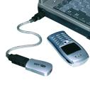


Infra red light.
Infrared refers to light waves of a lower frequency than human eyes can receive and interpret. Infrared is used in most television remote control systems, and with a standard called IrDA (Infrared Data Association) it's used to connect some computers with peripheral devices. For most of these computer and entertainment purposes, infrared is used in a digital mode -- the signal is pulsed on and off very quickly to send data from one point to another.
Advantages Infrared communications are fairly reliable and don't cost very much to build into a device.
Disadvantages
It can only travel short distances.
Infrared is a "line of sight" technology.
Infrared is almost always a "one to one" technology.

Slide 30
Wireless networking- cable less connectivity
Radio Transmission
Devices have radio transmission facilities and radio receivers. These radio receivers constantly scan the airways for incoming signals. When it detects the signal it recognises it captures it and converts it to digital form. The digital signal can be transmitted to the CPU by wireless routers
Examples
People now need to be mobile and still access their networks, email accounts e.g. at wireless nodes in an airport
Part of a WAN or Virtual Private Network e.g. a delivery driver using a hand held device to confirm deliveries with a central database

Slide 31
More examples….
Landscape gardeners use a laptop with wireless connectivity to access a library of garden designs back at HQ
Doctors at the scene of an accident can accessing patient records.
Wireless networks may be used as part of a LAN e.g. a mobile bar code reader in a warehouse transmitting data to a shop or HQ
Hand held chip and pin data entry in restaurants for entering details of cars payments.
Wireless devices such as Printers/ keyboards/mobile phones and description of use.

Slide 32
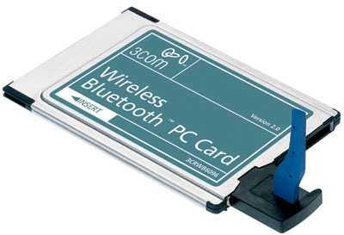
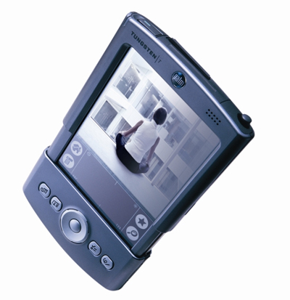

Bluetooth technology
The Bluetooth PDA Adapter Card,
PC Card, and USB Adapter plug into
your PDA, PC, or notebook
computer, enable the user to
effortlessly transfer data to other
Bluetooth devices such as desktop or
notebook computers, input devices,
PDAs, scanners, printers, and even
mobile phones. Connect with up to
seven other Bluetooth devices at a
time.

Slide 33
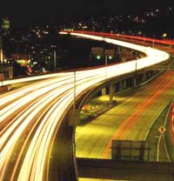
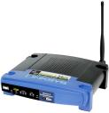
Broadband and wireless networking
The broadband connection gives faster access speeds to the Internet and wireless routers give wireless connection to the wireless adaptor in your PC. Average home speeds of about 54 Mps are possible.
Wireless technology means no cables
Allows remote use in wireless zones such as airports and hotels.

Slide 34
Advantages of Broadband
Faster connection when you want to be online
Savings on telephone bills
Faster downloading of programs, email, attachments songs, graphics-rich sites, animations and video clips
Play interactive games at top speed against gamers around the globe
Use telephone and be on the Internet
Realtime services such as web cams, radio better quality
Work from home with high speed access to corporate networks

Slide 35
Disadvantages
Higher subscription costs
Local exchanges may not be capable of very high speed digital transmission

Slide 36
Software components of a network
User accounts and logs
Each user must have an account with a user name and password.
The account will have permissions i.e. access rights to files and data such as read only, right only, read and write, and there will be restrictions of programs or data they can access. e.g. a member of the Personnel Department may be able to write, add and delete files of workers but a worker may only be able to read their personnel file.
The resources; disk space, printers they can use etc will be allocated to their account.

Slide 37
Auditing
Auditing software keeps a record of who has logged on, when, how long, what programs and data was used and what was amended. Therefore any illicit use of the system can be tracked and evidenced.

Slide 38
Remote management
Networks can now be managed remotely from other rooms, buildings or across many sites by network management companies. e.g.
A workstation left unattended can be logged off.
Network managers can observe what users are doing.
Remote technicians can find and fix software problems with the network
Security and backup strategy – See Disaster planning

Slide 39
Factors to be considered when making configuration choices.
Applications Software choices
What applications e.g. an ‘Office type’ suite would allow easier maintenance and support from IT staff and documents and other data can be shared.
What appearance on the desktop will be allowed?
Restrictions on downloading to prevent harmful software for personal use.
Operating systems and network management
software
What operating systems and network is suitable?
Windows 2000/ XP network; UNIX ??

Slide 40
Hardware
What hardware is on the network? Ideally everyone should have identical workstations to make maintenance simpler but this does not often happen as existing workstation have to be added to a newer network. Replacing all workstations would be too expensive for most organisations and time for installation needs to be staggered so the company can continue functioning. What peripherals should be on the network and who has access to them.
Range of User needs
Some users will have different skills and requirements. Some may only use 1 package occasionally whilst other uses very technically demanding software constantly. The skills users have already and their confidence in using them must be considered and retraining given if required.

Slide 41
Future proofing
Make sure the system has a reasonable life span. Many companies replace computers every 3 to4 years as they become too slow to cope with modern software.
The format of the data must be considered. Old archived data must be able to be processed as well as new data.
Storage mediums must be capable of being read in the future.
Programs must have backward compatibility.
Network cabling and network infrastructure such as routers, bridges, switches and servers installed must be capable of taking an expansion in future traffic at reasonable speed
When making choices it must be flexible and able to expand. Avoid over reliance on one supplier as if they go you may not have the expertise to fix problems.
Having an up to date ICT system can inspire confidence in customers and give staff better working conditions.

